Slide 1
GPT-2
Generative Pre-trained Transformer 2
Nguyễn Duy Tuấn: 520K0232
Trịnh Bảo Toàn: 520K0332

Slide 2
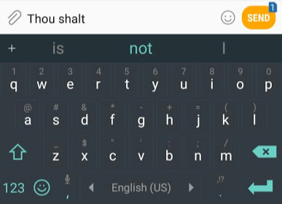
What is Language Model
The most famous language models are smartphone keyboards that suggest the next word based on what you’ve currently typed.

Slide 3
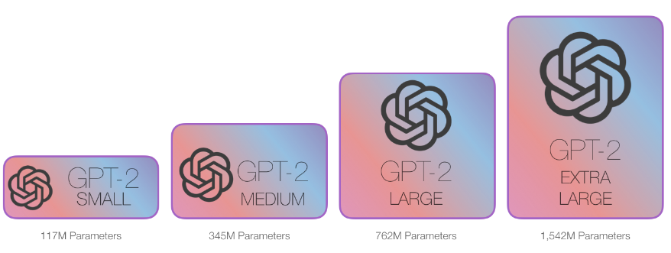
In this sense, we can say that the GPT-2 is basically the next word prediction feature of a keyboard app, but one that is much larger and more sophisticated than what your phone has. The GPT-2 was trained on a massive 40GB dataset called WebText that the OpenAI researchers crawled from the internet as part of the research effort. To compare in terms of storage size, the keyboard app I use, SwiftKey, takes up 78MBs of space. The smallest variant of the trained GPT-2, takes up 500MBs of storage to store all of its parameters. The largest GPT-2 variant is 13 times the size so it could take up more than 6.5 GBs of storage space.

Slide 4
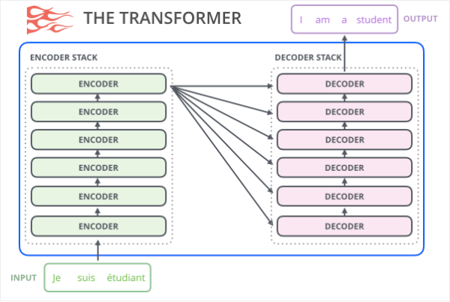
Transformers for Language Modeling
The original transformer model is made up of an encoder and decoder – each is a stack of what we can call transformer blocks. That architecture was appropriate because the model tackled machine translation – a problem where encoder-decoder architectures have been successful in the past.

Slide 5
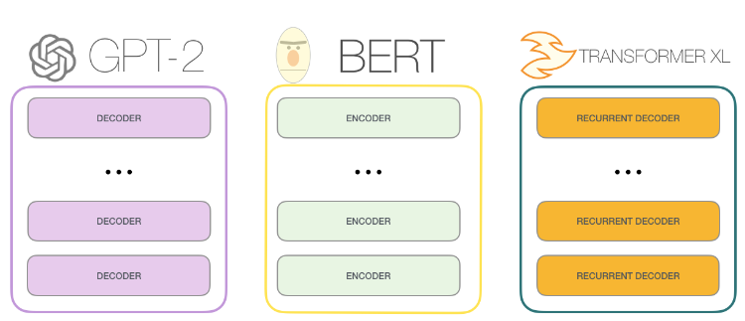
A lot of the subsequent research work saw the architecture shed either the encoder or decoder, and use just one stack of transformer blocks – stacking them up as high as practically possible, feeding them massive amounts of training text, and throwing vast amounts of compute at them

Slide 6
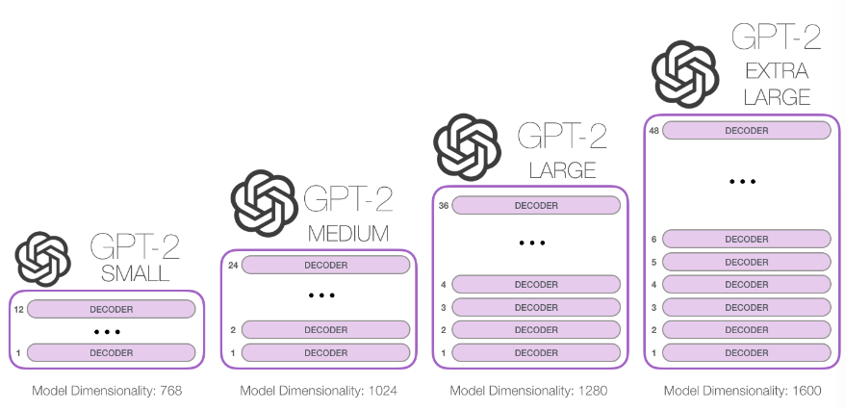
How high can we stack up these blocks?
It turns out that’s one of the main distinguishing factors between the different GPT2 model sizes:

Slide 7
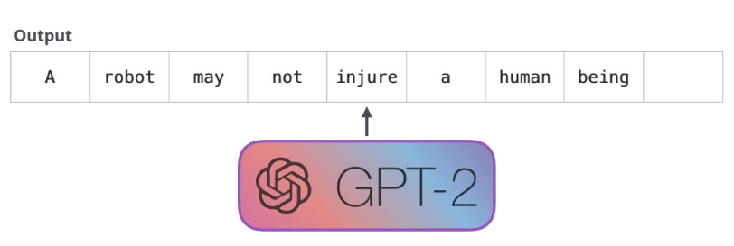
One difference From Bert
The GPT-2 is built using transformer decoder blocks. BERT, on the other hand, uses transformer encoder blocks. We will examine the difference in a following section. But one key difference between the two is that GPT2, like traditional language models, outputs one token at a time. Let’s for example prompt a well-trained GPT-2 to recite the first law of robotics:

Slide 8
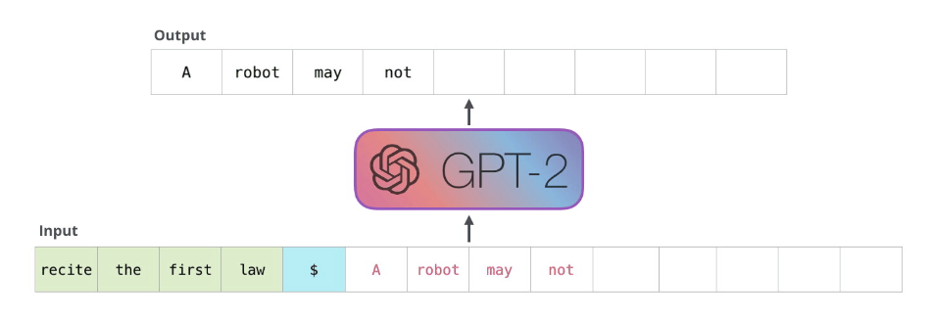
The way these models actually work is that after each token is produced, that token is added to the sequence of inputs. And that new sequence becomes the input to the model in its next step. This is an idea called “auto-regression”. This is one of the ideas that made RNNs unreasonably effective.
The GPT2, and some later models like TransformerXL and XLNet are auto-regressive in nature. BERT is not. That is a trade off. In losing auto-regression, BERT gained the ability to incorporate the context on both sides of a word to gain better results. XLNet brings back autoregression while finding an alternative way to incorporate the context on both sides.

Slide 9
The Evolution of the Transformer Block
Two types of transformer blocks
The Encode Block
The Decoder Block

Slide 10
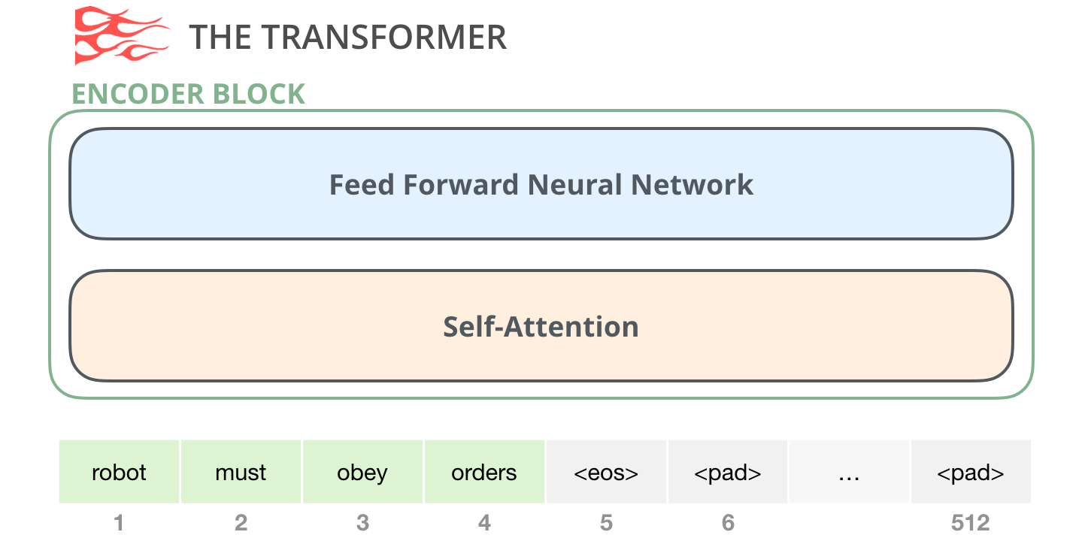
The Encoder Block
An encoder block from the original transformer paper can take inputs up until a certain max sequence length (e.g. 512 tokens). It's okay if an input sequence is shorter than this limit, we can just pad the rest of the sequence.

Slide 11
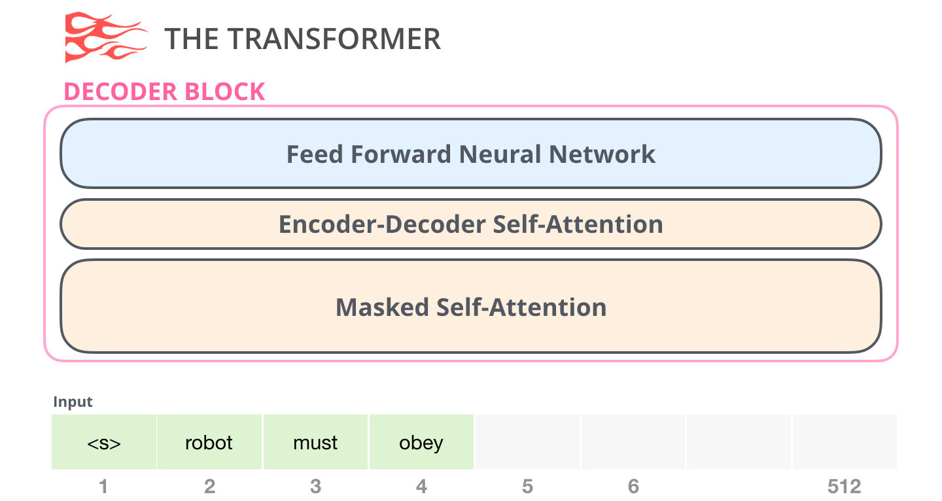
The Decoder Block
there’s the decoder block which has a small architectural variation from the encoder block – a layer to allow it to pay attention to specific segments from the encoder:

Slide 12
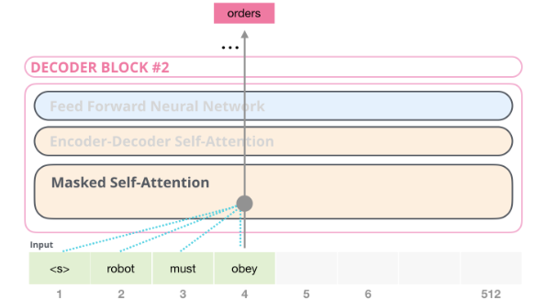
One key difference in the self-attention layer here, is that it masks future tokens – not by changing the word to [mask] like BERT, but by interfering in the self-attention calculation blocking information from tokens that are to the right of the position being calculated.
If, for example, we’re to highlight the path of position #4, we can see that it is only allowed to attend to the present and previous tokens:

Slide 13
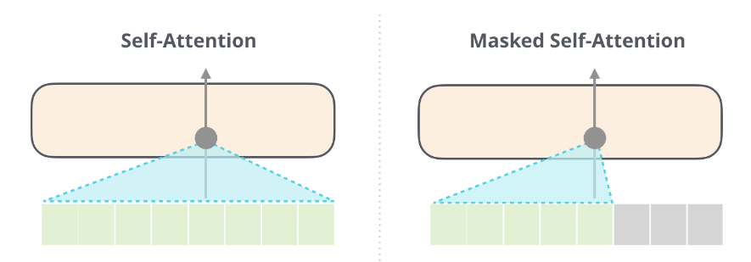
It’s important that the distinction between self-attention (what BERT uses) and masked self-attention (what GPT-2 uses) is clear. A normal *self-attention block allows a position to peak at tokens to its right. *Masked self-attention prevents that from happening:

Slide 14
Self-attention is an attention mechanism that relates different positions of a single sequence in order to compute a representation of the sequence. Allowing the model to weigh the importance of different positions of the input sequence to compute a representation of each position
Masked self-attention is a variant of self-attention that allows a model to attend to all positions in the input sequence except for those that come after the current position. This is useful when training a model to generate text one word at a time, as it prevents the model from “cheating” by looking ahead at words it hasn’t generated yet

Slide 15
The Decoder-Only Block
Subsequent to the original paper, Generating Wikipedia by Summarizing Long Sequences proposed another arrangement of the transformer block that is capable of doing language modeling. This model threw away the Transformer encoder. For that reason, let’s call the model the “Transformer-Decoder”. This early transformer-based language model was made up of a stack of six transformer decoder blocks:

Slide 16
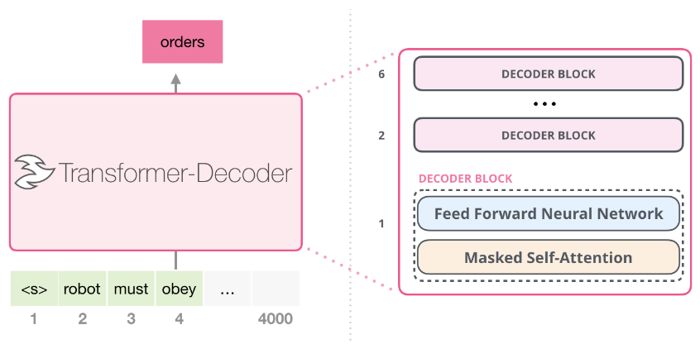
The decoder blocks are identical. I have expanded the first one so you can see its self-attention layer is the masked variant. Notice that the model now can address up to 4,000 tokens in a certain segment -- a massive upgrade from the 512 in the original transformer.

Slide 17
These blocks were very similar to the original decoder blocks, except they did away with that second self-attention layer. A similar architecture was examined in Character-Level Language Modeling with Deeper Self-Attention to create a language model that predicts one letter/character at a time.
The OpenAI GPT-2 model uses these decoder-only blocks.

Slide 18
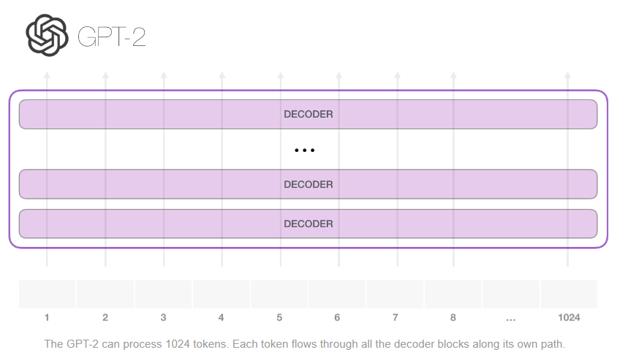
Looing Inside GPT-2

Slide 19
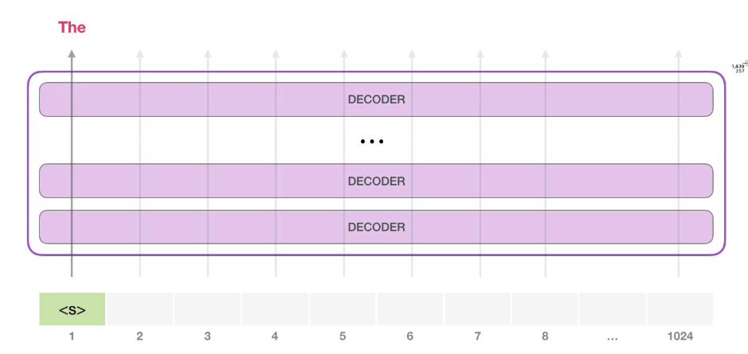
The simplest way to run a trained GPT-2 is to allow it to ramble on its own (which is technically called generating unconditional samples) – alternatively, we can give it a prompt to have it speak about a certain topic (a.k.a generating interactive conditional samples). In the rambling case, we can simply hand it the start token and have it start generating words (the trained model uses <|endoftext|> as its start token. Let’s call it <s> instead).

Slide 20
The model only has one input token, so that path would be the only active one. The token is processed successively through all the layers, then a vector is produced along that path. That vector can be scored against the model’s vocabulary (all the words the model knows, 50,000 words in the case of GPT-2). In this case we selected the token with the highest probability, ‘the’. But we can certainly mix things up – you know how if you keep clicking the suggested word in your keyboard app, it sometimes can stuck in repetitive loops where the only way out is if you click the second or third suggested word. The same can happen here. GPT-2 has a parameter called top-k that we can use to have the model consider sampling words other than the top word (which is the case when top-k = 1).
In the next step, we add the output from the first step to our input sequence, and have the model make its next prediction:

Slide 21
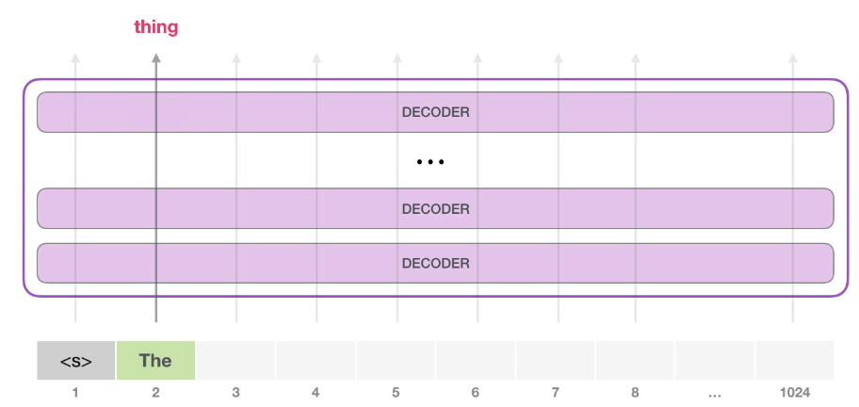
Notice that the second path is the only that’s active in this calculation. Each layer of GPT-2 has retained its own interpretation of the first token and will use it in processing the second token (we’ll get into more detail about this in the following section about self-attention). GPT-2 does not re-interpret the first token in light of the second token.

Slide 22
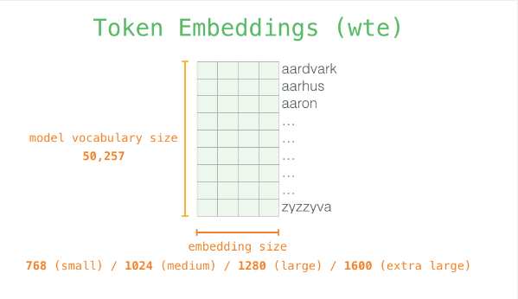
A Deeper Look Inside: Input Encoding
Each row is a word embedding: a list of numbers representing a word and capturing some of its meaning. The size of that list is different in different GPT2 model sizes. The smallest model uses an embedding size of 768 per word/token.

Slide 23
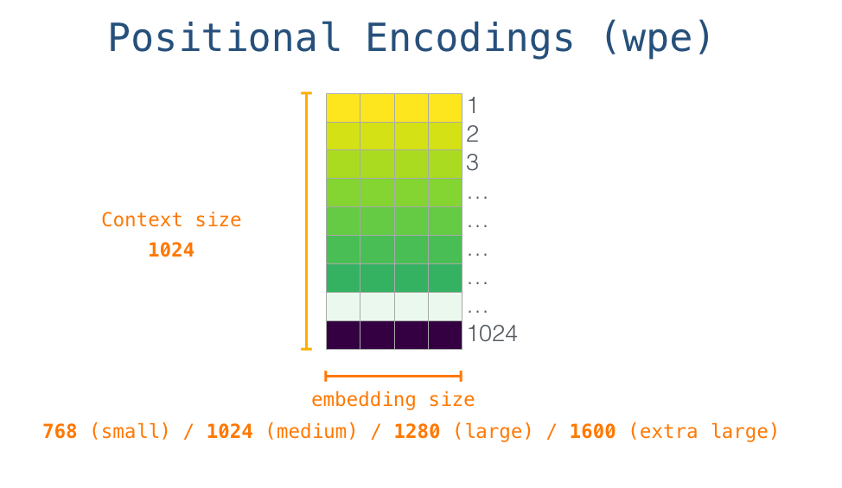
So in the beginning, we look up the embedding of the start token <s> in the embedding matrix. Before handing that to the first block in the model, we need to incorporate positional encoding – a signal that indicates the order of the words in the sequence to the transformer blocks. Part of the trained model is a matrix that contains a positional encoding vector for each of the 1024 positions in the input.

Slide 24
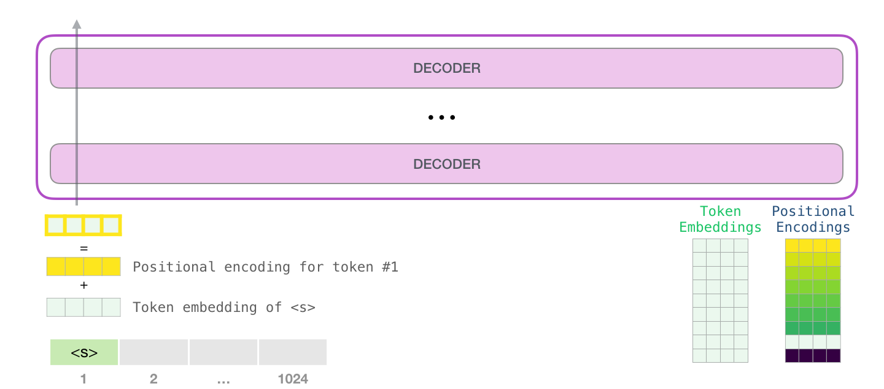
With this, we’ve covered how input words are processed before being handed to the first transformer block. We also know two of the weight matrices that constitute the trained GPT-2.
Sending a word to the first transformer block means looking up its embedding and adding up the positional encoding vector for position #1.

Slide 25
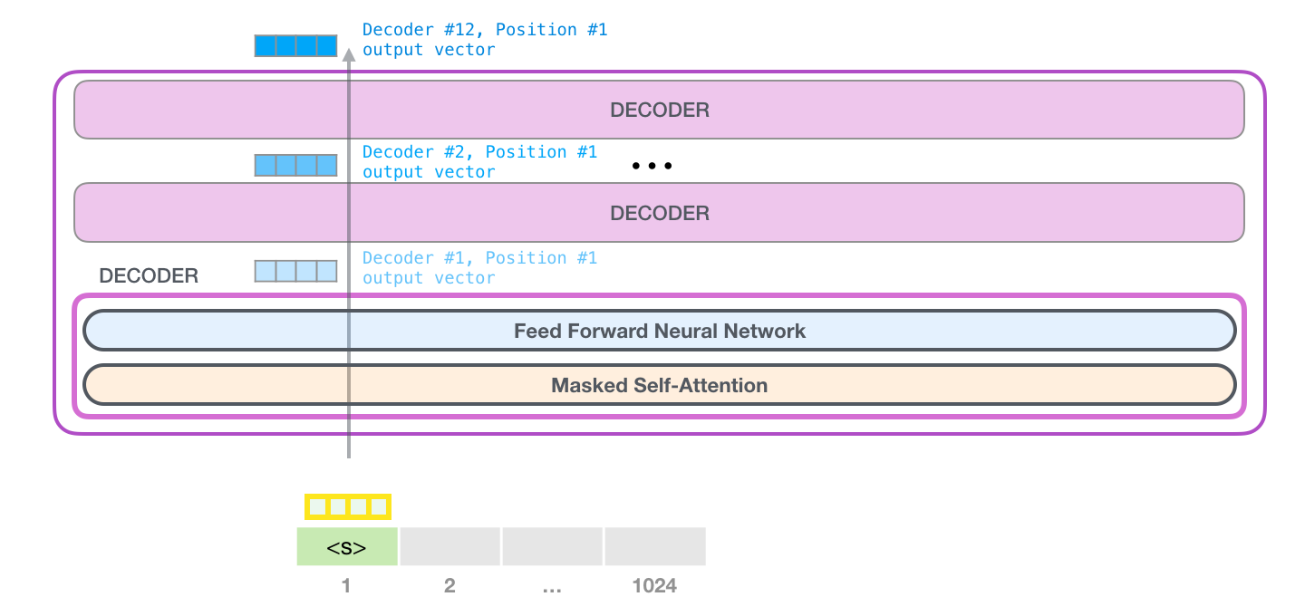
A journey up the Stack
The first block can now process the token by first passing it through the self-attention process, then passing it through its neural network layer. Once the first transformer block processes the token, it sends its resulting vector up the stack to be processed by the next block. The process is identical in each block, but each block has its own weights in both self-attention and the neural network sublayers.

Slide 26
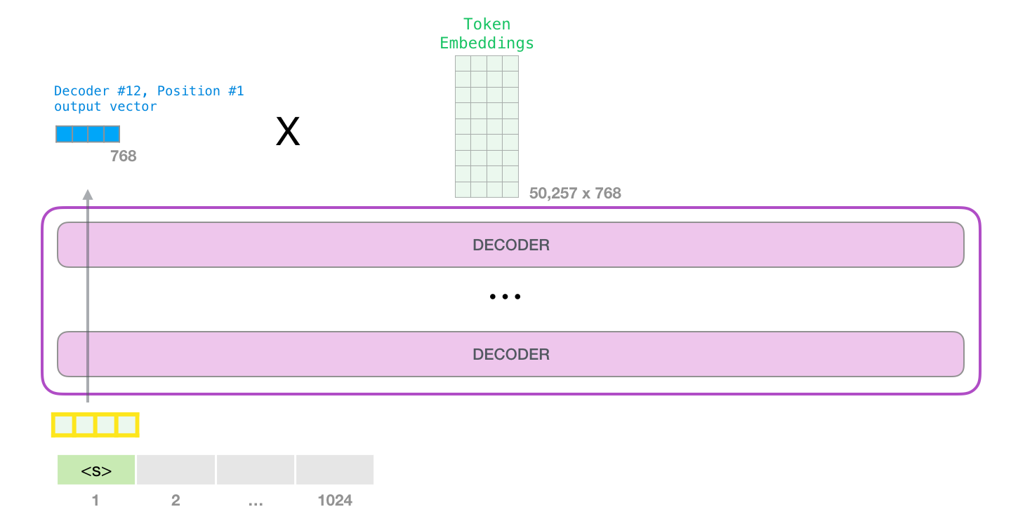
Model Output
When the top block in the model produces its output vector (the result of its own self-attention followed by its own neural network), the model multiplies that vector by the embedding matrix.

Slide 27
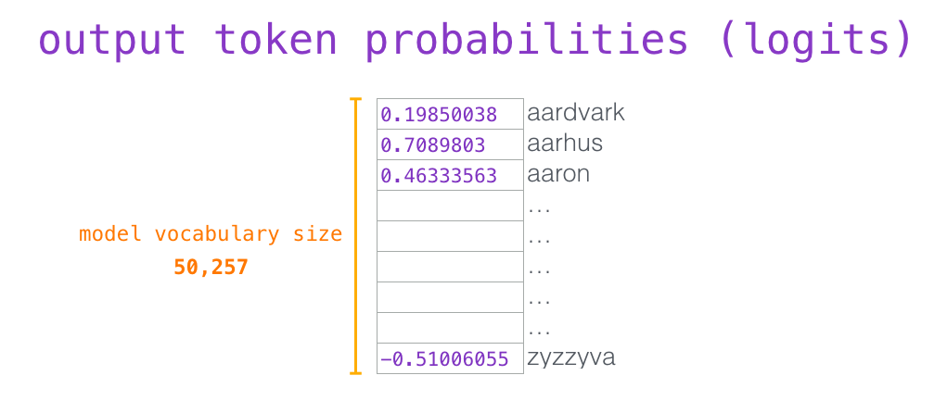
Recall that each row in the embedding matrix corresponds to the embedding of a word in the model’s vocabulary. The result of this multiplication is interpreted as a score for each word in the model’s vocabulary.

Slide 28
We can simply select the token with the highest score (top_k = 1). But better results are achieved if the model considers other words as well. So a better strategy is to sample a word from the entire list using the score as the probability of selecting that word (so words with a higher score have a higher chance of being selected). A middle ground is setting top_k to 40, and having the model consider the 40 words with the highest scores.

Slide 29
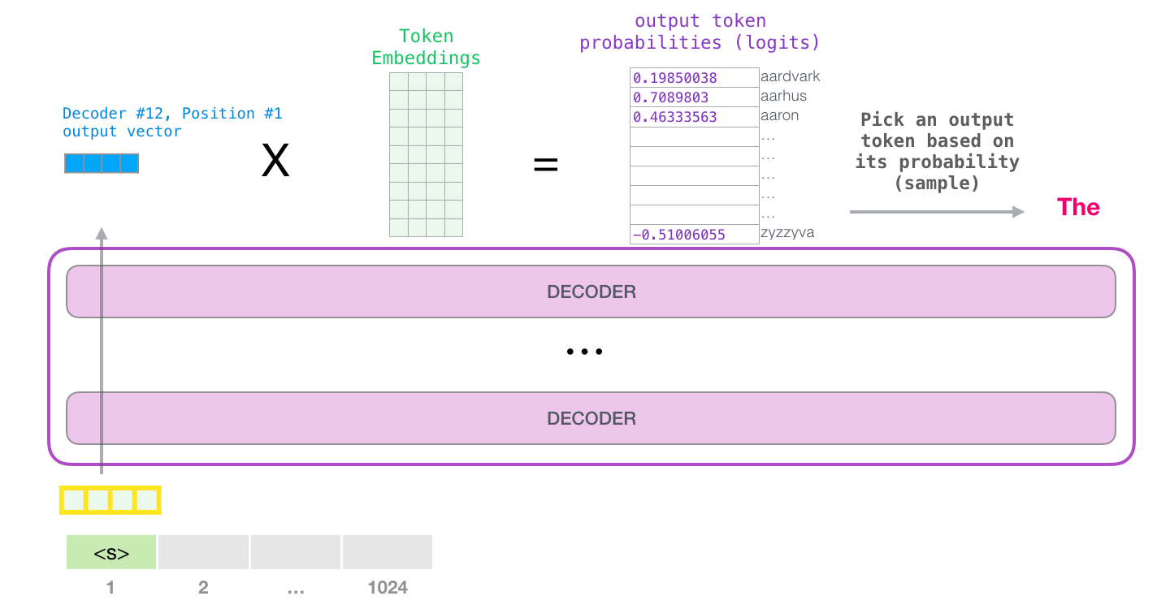
With that, the model has completed an iteration resulting in outputting a single word. The model continues iterating until the entire context is generated (1024 tokens) or until an end-of-sequence token is produced.

Slide 30
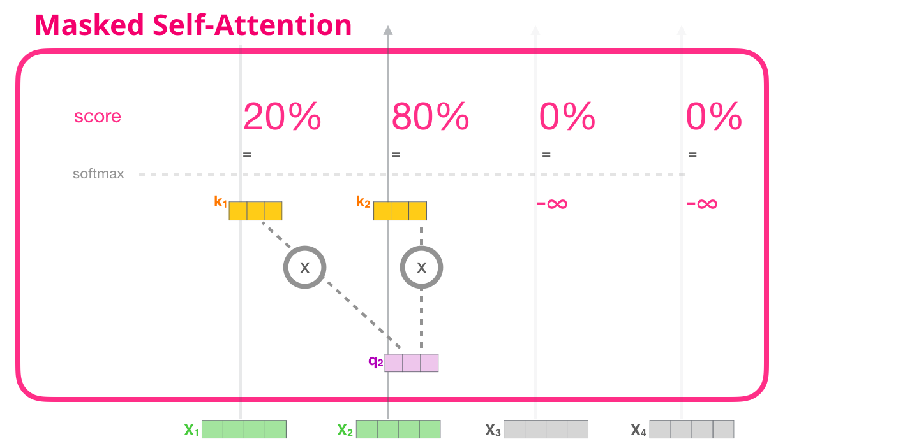
Masked Self-Attention
Masked self-attention is identical to self-attention except when it comes to step #2. Assuming the model only has two tokens as input and we’re observing the second token. In this case, the last two tokens are masked. So the model interferes in the scoring step. It basically always scores the future tokens as 0 so the model can’t peak to future words:

Slide 31
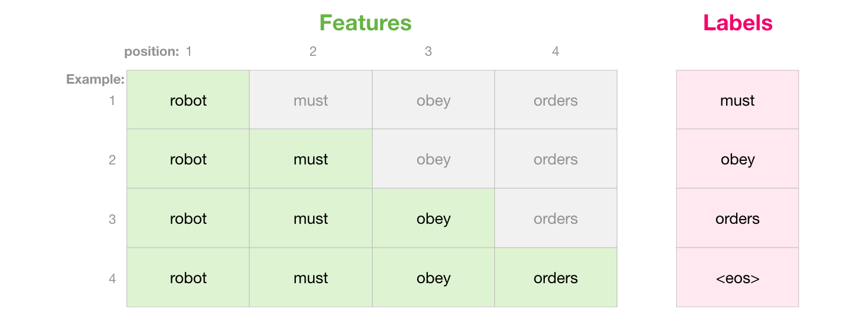
This masking is often implemented as a matrix called an attention mask. Think of a sequence of four words (“robot must obey orders”, for example). In a language modeling scenario, this sequence is absorbed in four steps – one per word (assuming for now that every word is a token). As these models work in batches, we can assume a batch size of 4 for this toy model that will process the entire sequence (with its four steps) as one batch.

Slide 32
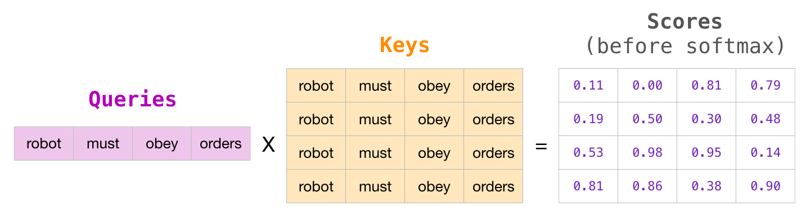
In matrix form, we calculate the scores by multiplying a queries matrix by a keys matrix. Let’s visualize it as follows, except instead of the word, there would be the query (or key) vector associated with that word in that cell:

Slide 33
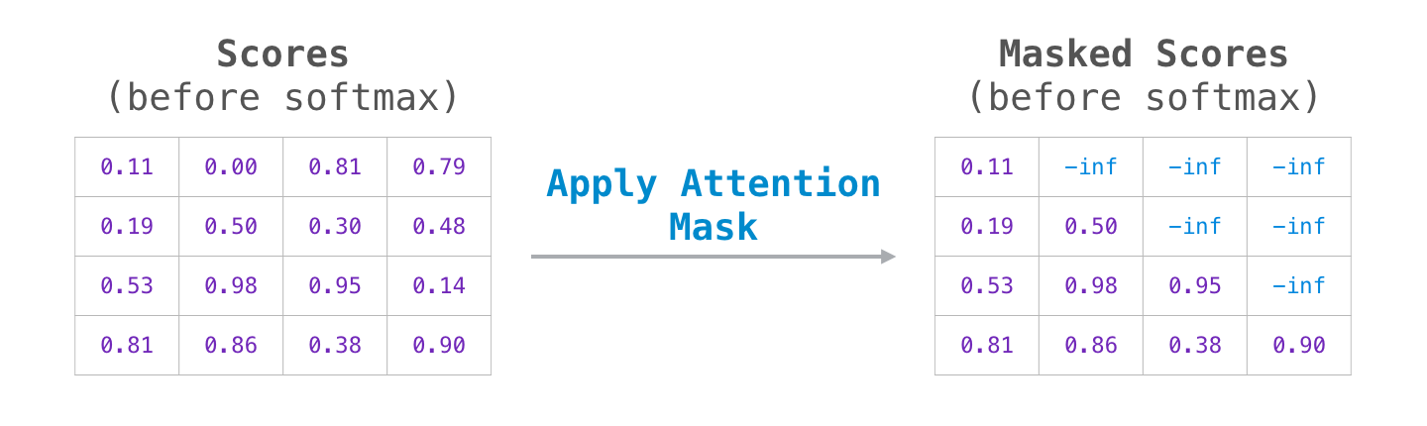
After the multiplication, we slap on our attention mask triangle. It set the cells we want to mask to -infinity or a very large negative number (e.g. -1 billion in GPT2):

Slide 34
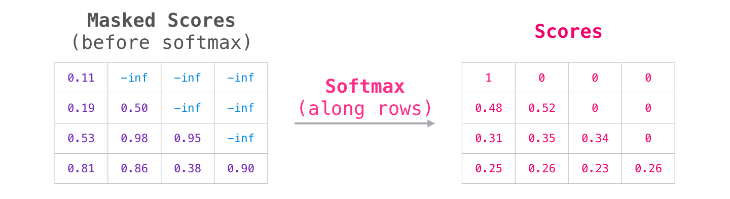
Then, applying softmax on each row produces the actual scores we use for self-attention:

Slide 35
What this scores table means is the following:
When the model processes the first example in the dataset (row #1), which contains only one word (“robot”), 100% of its attention will be on that word.
When the model processes the second example in the dataset (row #2), which contains the words (“robot must”), when it processes the word “must”, 48% of its attention will be on “robot”, and 52% of its attention will be on “must”.
And so on

Slide 36
GPT-2 Masked Self-Attention
Evaluation Time: Processing One Token at a Time
We can make the GPT-2 operate exactly as masked self-attention works. But during evaluation, when our model is only adding one new word after each iteration, it would be inefficient to recalculate self-attention along earlier paths for tokens which have already been processed.
In this case, we process the first token (ignoring <s> for now).

Slide 37
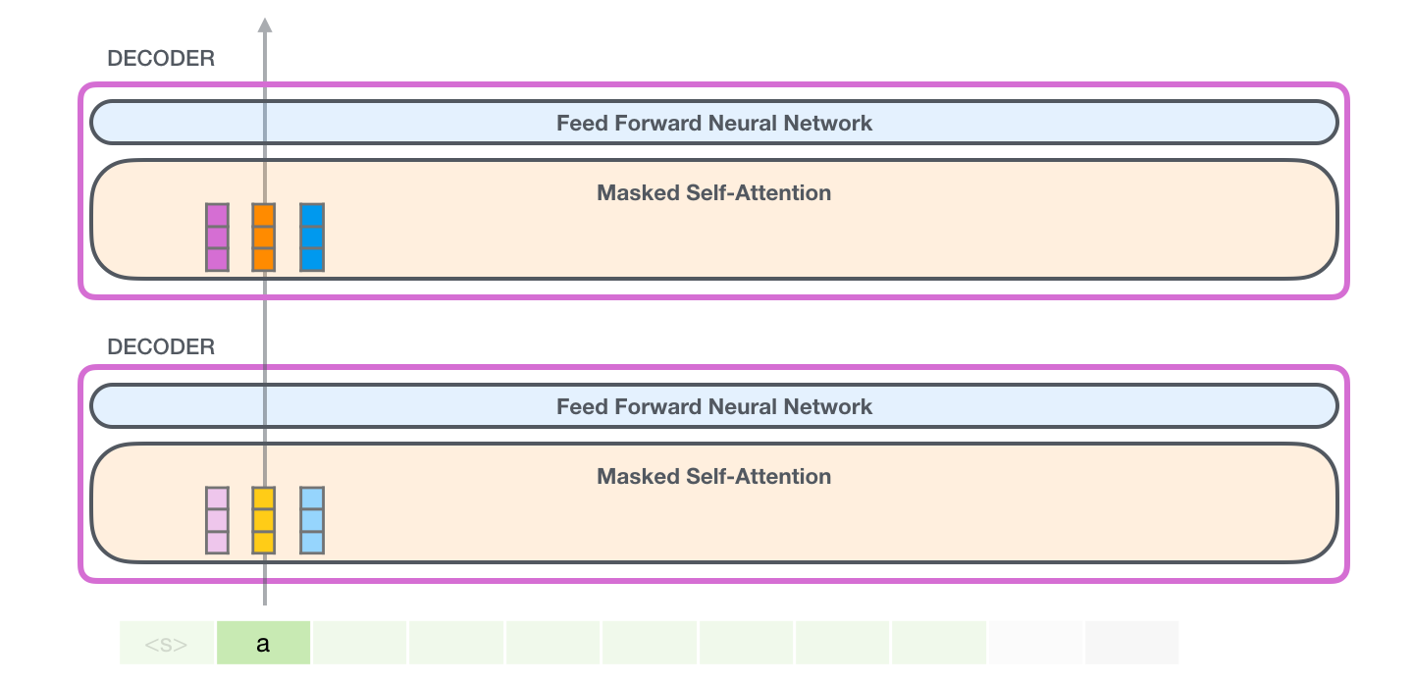

Slide 38
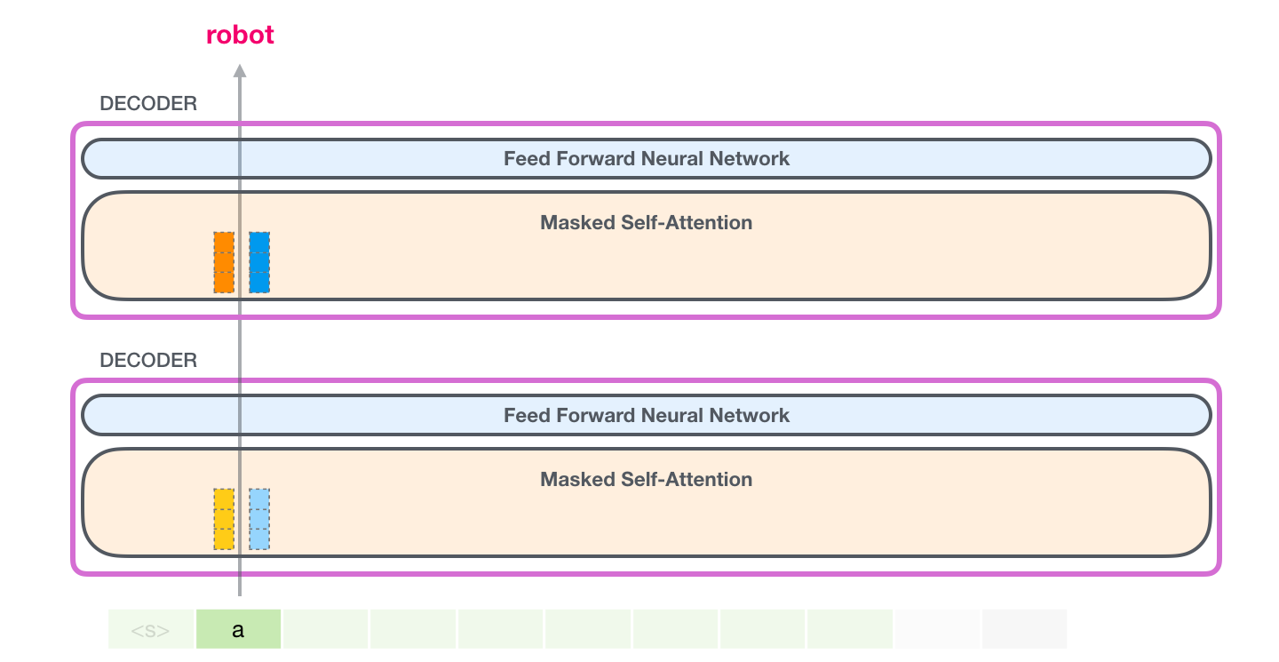
GPT-2 holds on to the key and value vectors of the the a token. Every self-attention layer holds on to its respective key and value vectors for that token:

Slide 39
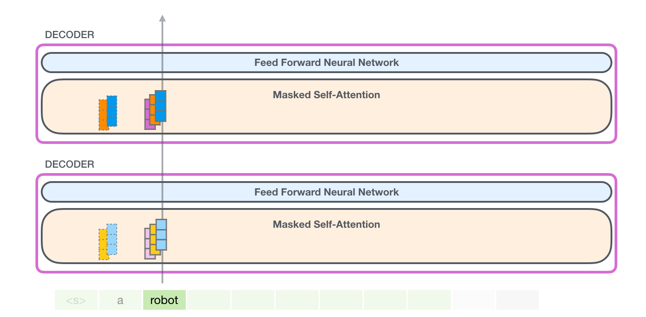
Now in the next iteration, when the model processes the word robot, it does not need to generate query, key, and value queries for the a token. It just reuses the ones it saved from the first iteration:

Slide 40
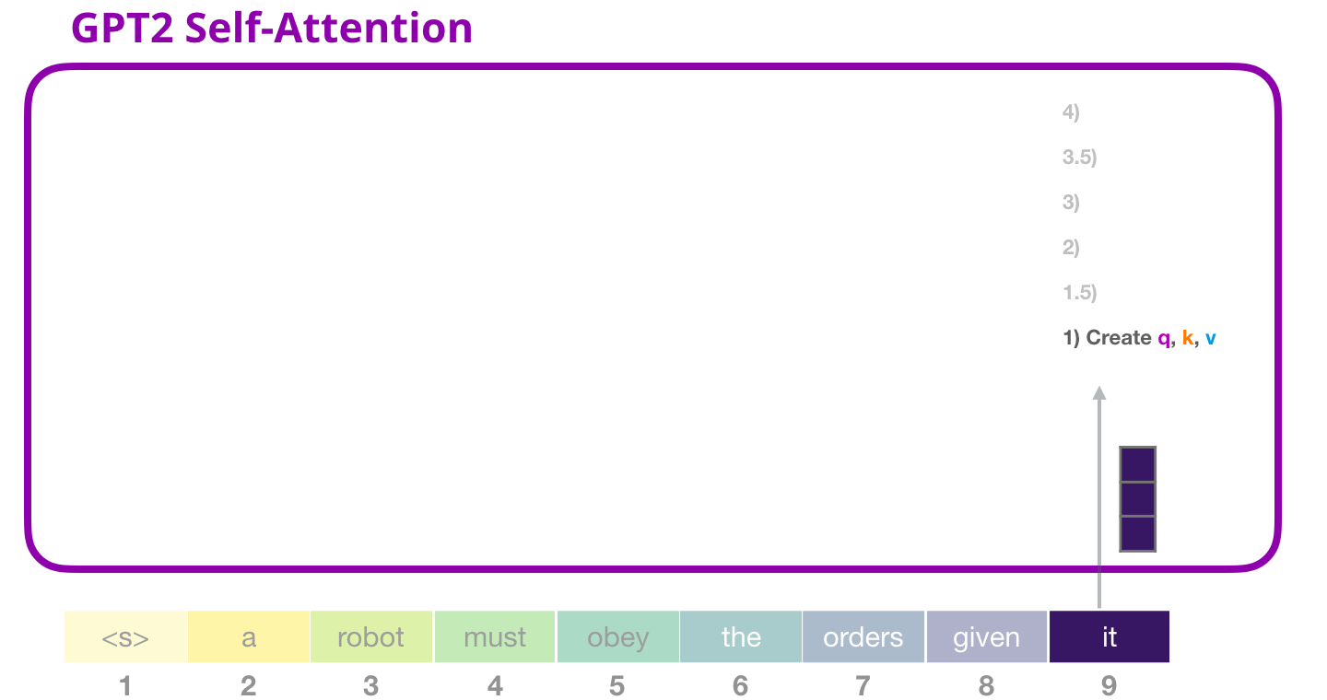
GPT-2 Self-attention: 1- Creating queries, keys, and values
Let’s assume the model is processing the word it. If we’re talking about the bottom block, then its input for that token would be the embedding of it + the positional encoding for slot #9:

Slide 41
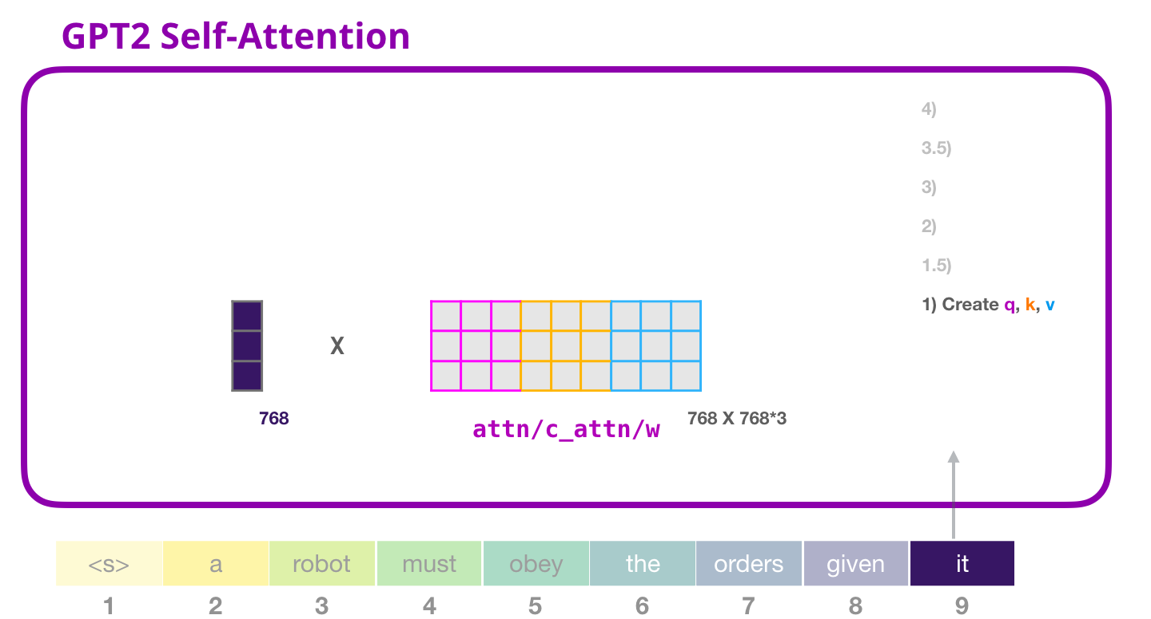
Every block in a transformer has its own weights (broken down later in the post). The first we encounter is the weight matrix that we use to create the queries, keys, and values

Slide 42
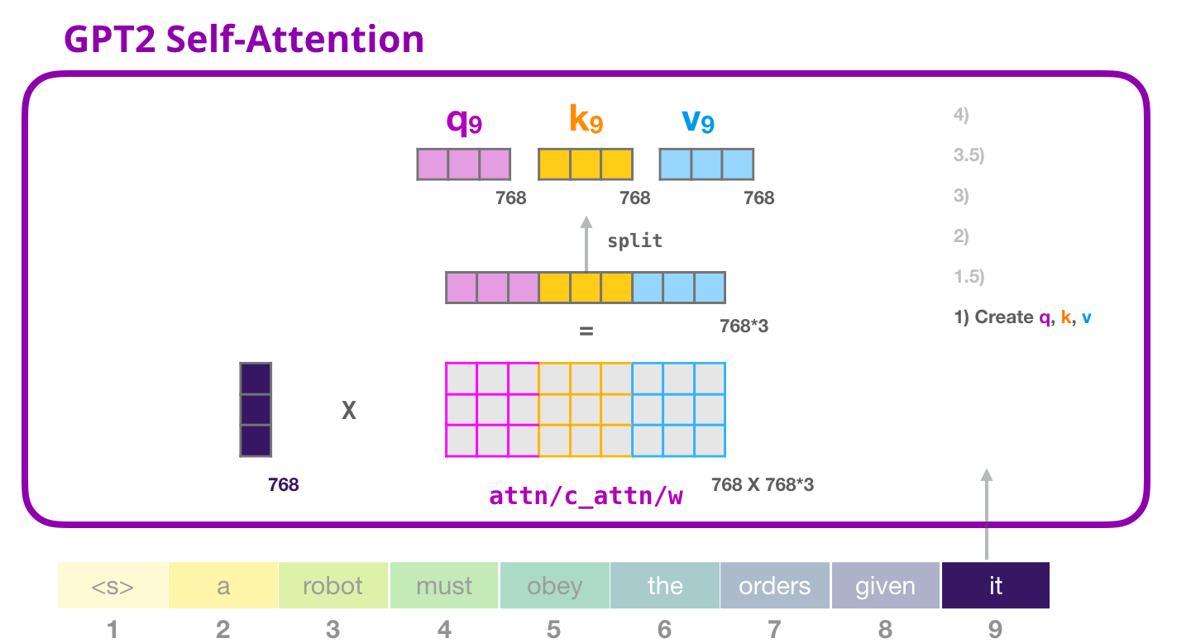
The multiplication results in a vector that’s basically a concatenation of the query, key, and value vectors for the word it.

Slide 43
GPT-2 Self-attention: 1.5- Splitting into attention heads
In the previous examples, we dove straight into self-attention ignoring the “multi-head” part. It would be useful to shed some light on that concept now. Self attention is conducted multiple times on different parts of the Q,K,V vectors. “Splitting” attention heads is simply reshaping the long vector into a matrix. The small GPT2 has 12 attention heads, so that would be the first dimension of the reshaped matrix:

Slide 44
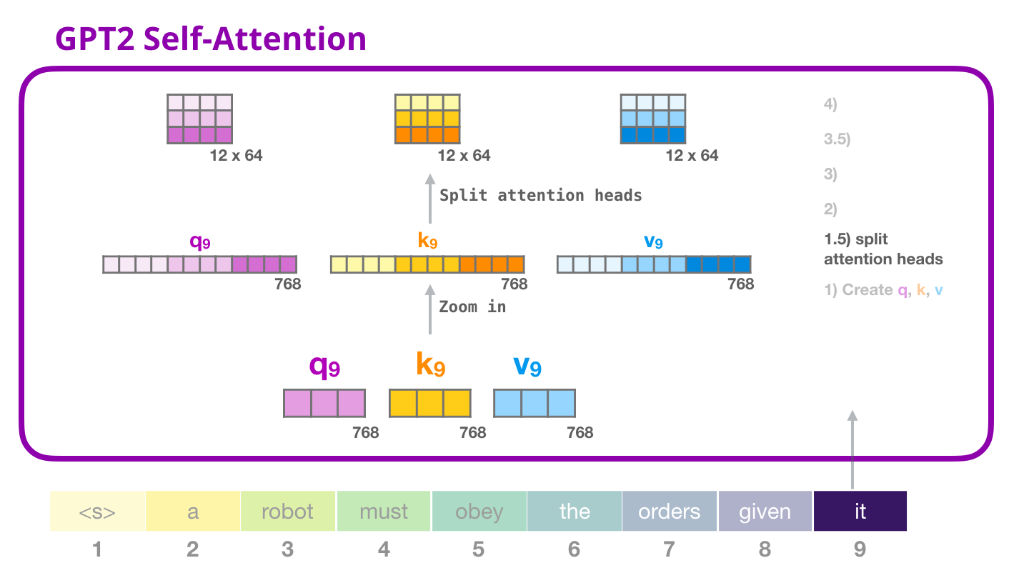

Slide 45
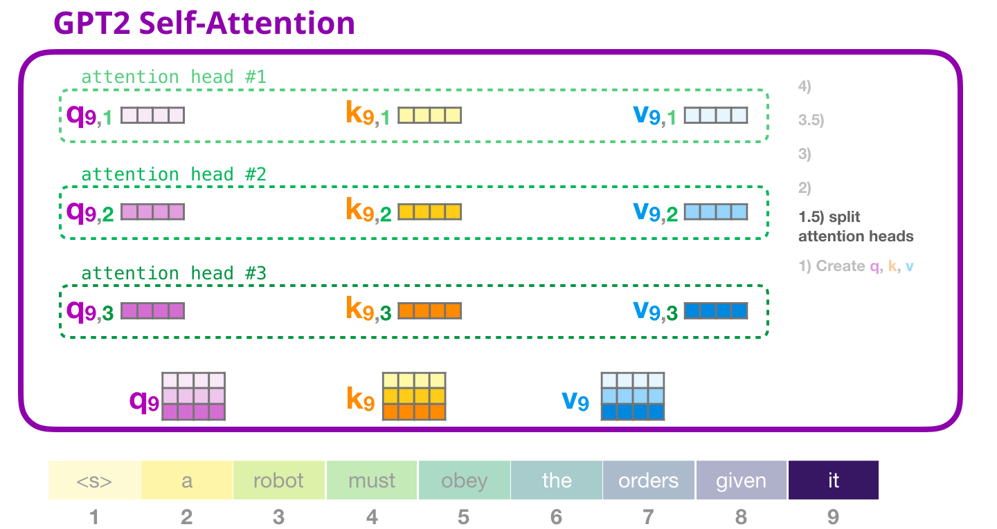
In the previous examples, we’ve looked at what happens inside one attention head. One way to think of multiple attention-heads is like this (if we’re to only visualize three of the twelve attention heads):

Slide 46
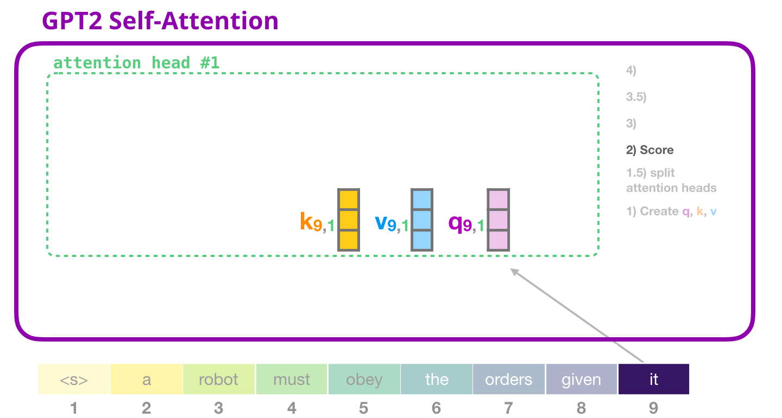
GPT-2 Self-attention: 2- Scoring
We can now proceed to scoring – knowing that we’re only looking at one attention head (and that all the others are conducting a similar operation):

Slide 47
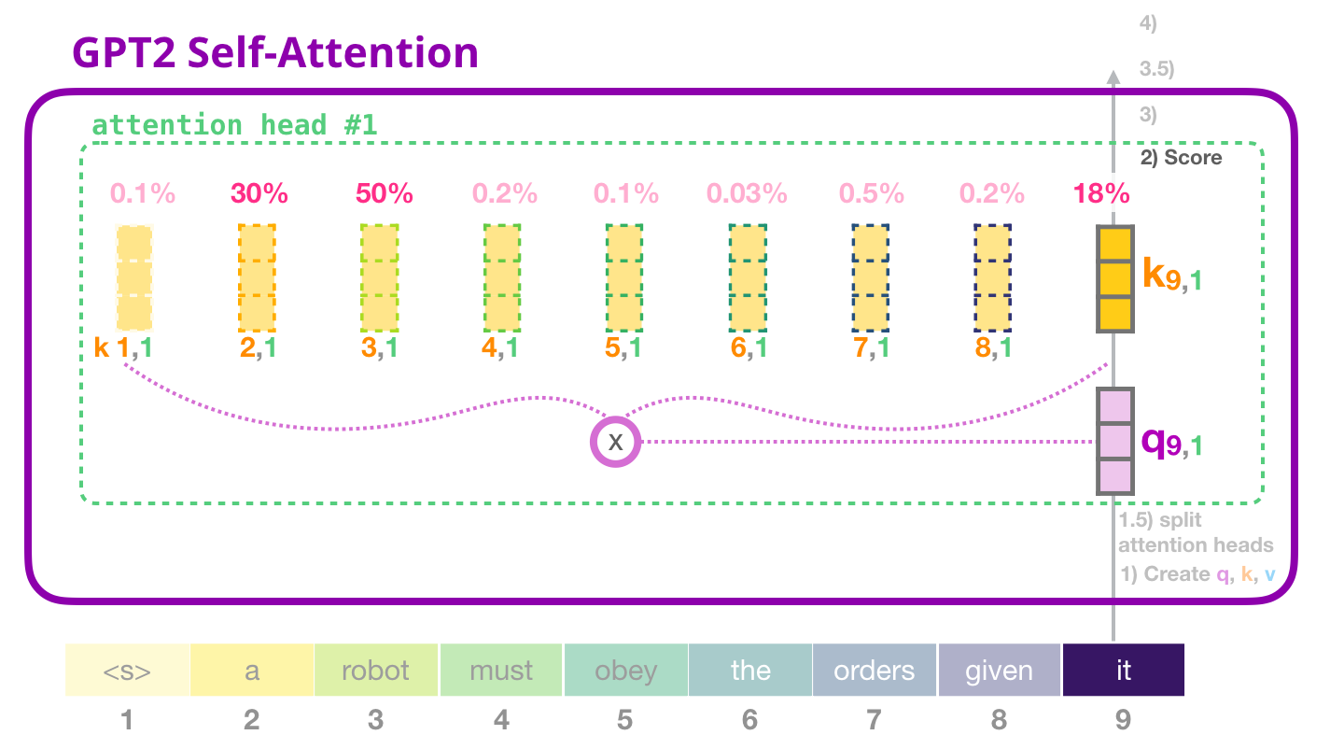
Now the token can get scored against all of keys of the other tokens (that were calculated in attention head #1 in previous iterations):

Slide 48
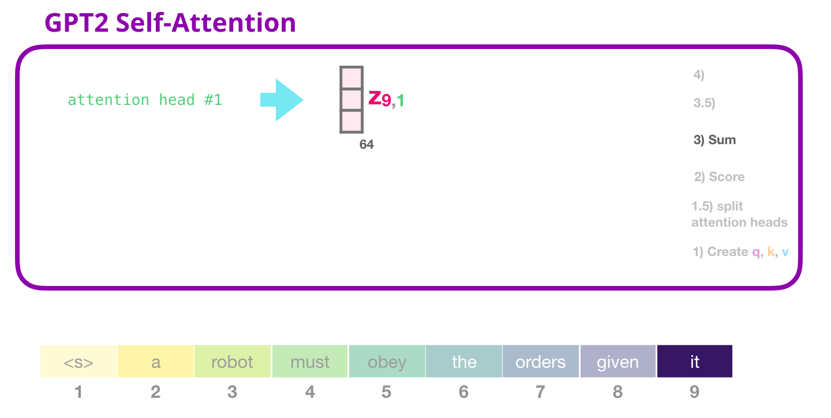
GPT-2 Self-attention: 3- Sum
As we’ve seen before, we now multiply each value with its score, then sum them up, producing the result of self-attention for attention-head #1:

Slide 49
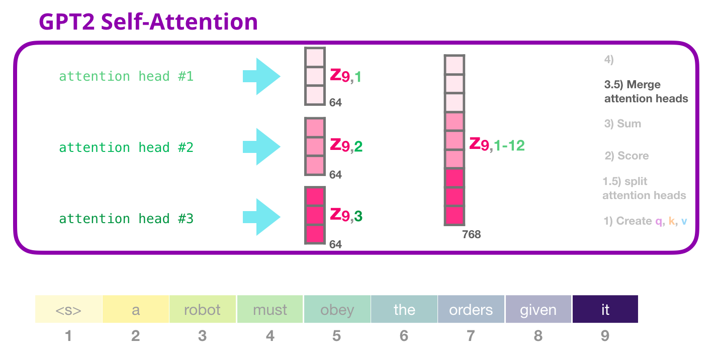
GPT-2 Self-attention: 3.5- Merge attention heads
The way we deal with the various attention heads is that we first concatenate them into one vector:

Slide 50
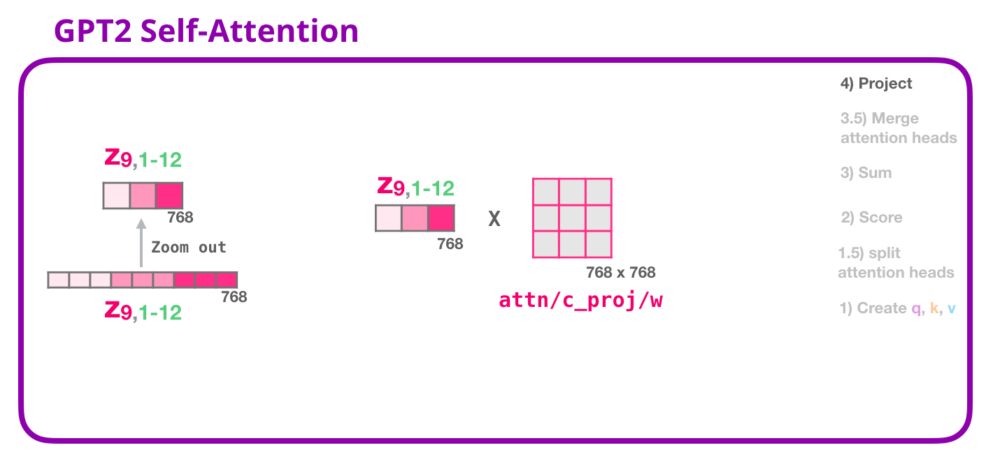
GPT-2 Self-attention: 4- Projecting
We’ll let the model learn how to best map concatenated self-attention results into a vector that the feed-forward neural network can deal with. Here comes our second large weight matrix that projects the results of the attention heads into the output vector of the self-attention sublayer:

Slide 51
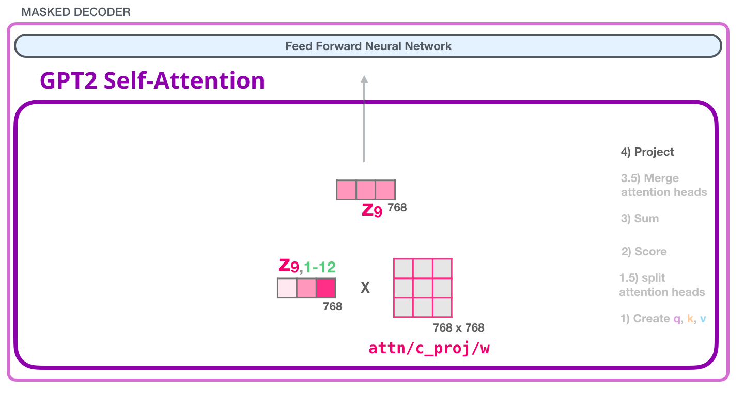
And with this, we have produced the vector we can send along to the next layer:

Slide 52
GPT-2 Fully-Connected Neural Network: Layer #1
The fully-connected neural network is where the block processes its input token after self-attention has included the appropriate context in its representation. It is made up of two layers. The first layer is four times the size of the model (Since GPT2 small is 768, this network would have 768*4 = 3072 units). Why four times? That’s just the size the original transformer rolled with (model dimension was 512 and layer #1 in that model was 2048). This seems to give transformer models enough representational capacity to handle the tasks that have been thrown at them so far.

Slide 54
GPT-2 Fully-Connected Neural Network: Layer #2 - Projecting to model dimension
The second layer projects the result from the first layer back into model dimension (768 for the small GPT2). The result of this multiplication is the result of the transformer block for this token.

Slide 55
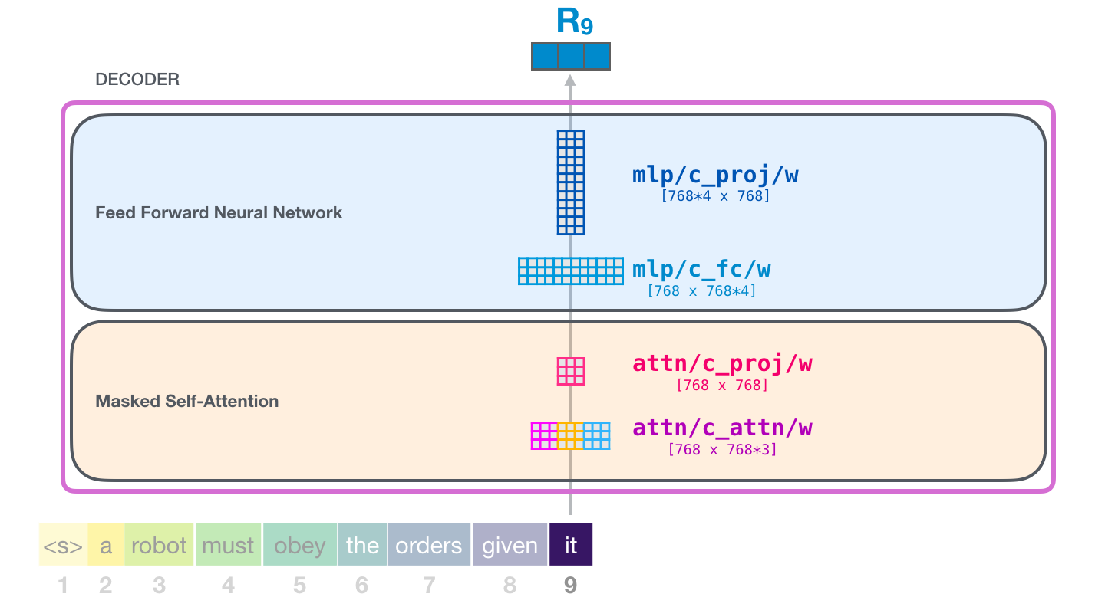

Slide 56
Summarization
This is the task that the first decoder-only transformer was trained on. Namely, it was trained to read a wikipedia article (without the opening section before the table of contents), and to summarize it. The actual opening sections of the articles were used as the labels in the training datasest:

Slide 57
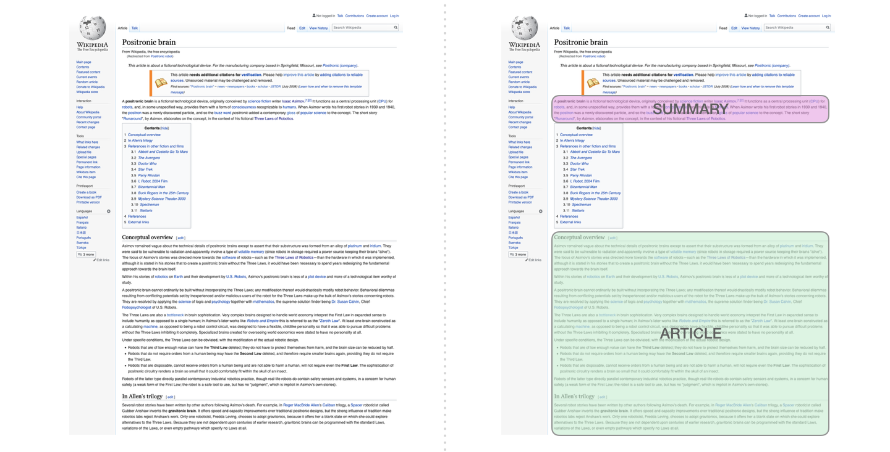

Slide 58
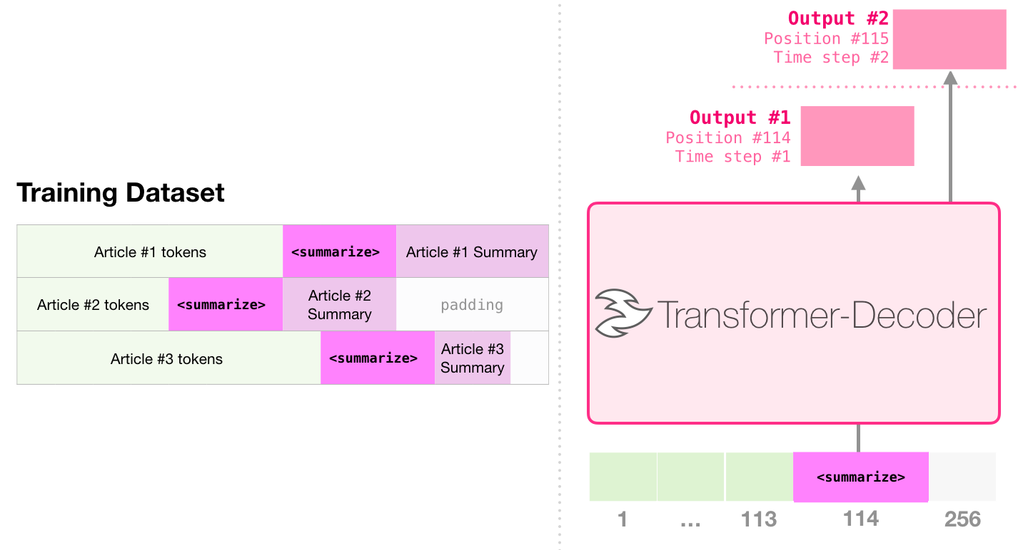
The paper trained the model against wikipedia articles, and thus the trained model was able to summarize articles:

